Slide 1

Capstone Project Phase A
Idiopathic pulmonary fibrosis classification using optimized Convolutional Neural Network
Alex Baboshin 310926415
Asaf Shnaider 316468636
(24-2-R-9)
Supervisor:
Prof. Miri Weiss Cohen

Slide 2
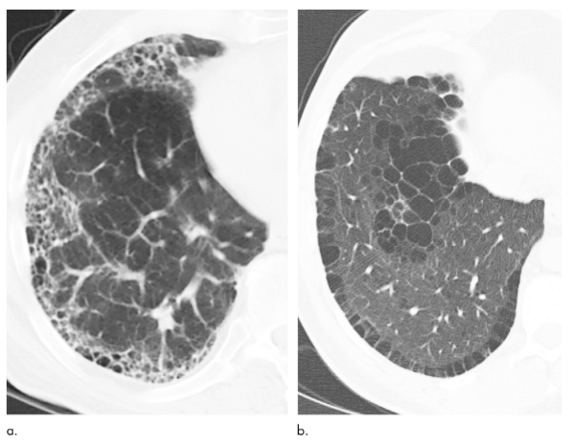
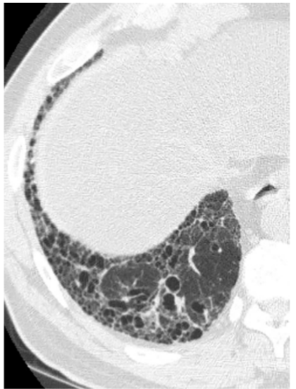
Introduction
Idiopathic Pulmonary Fibrosis (IPF)
IPF is a terminal disease that progressively causes scarring of the lungs impairs the ability to breathe, leading to severe respiratory distress.
By the time IPF reaches a critical stage, it is often too late for effective treatment.
Early Detection is Key
There is no cure for pulmonary fibrosis. Current treatments are aimed at preventing more lung scarring
We aim to create a system that detects IPF in its early stages before it reaches a critical point.
Early detection could lead to better treatment outcomes and improved quality of life for patients.
Why is This System Important?
Traditional diagnosis relies heavily on the human eye, which can sometimes miss subtle early signs.
Our system will use advanced AI and convolutional neural networks (CNNs) to detect early signs of IPF more accurately than human assessment.
Visual Markers of IPF
Honeycombing: Clustered cysts in the lungs that make it difficult to breathe.
Reticular Patterns: Mesh-like structures that appear in lung scans, indicating scarring.
Impact on Patients
Patients with IPF experience chronic coughing, shortness of breath, and severe discomfort in daily life.
Our goal is to reduce patient suffering through improved diagnostics and early intervention.

Slide 3
Motivation
Building a System for Better Diagnosis
Our goal is to develop a system that supports doctors in diagnosing Idiopathic Pulmonary Fibrosis (IPF).
The system will save time by providing quick and accurate results, reducing delays in treatment.
Saving Lives Through Early Detection
Early diagnosis of IPF can improve treatment outcomes and save lives.
By using AI to detect early signs, we can help patients receive care sooner, when it’s most effective.
Enhancing Efficiency in Healthcare
Our system aims to reduce the workload for doctors, allowing them to focus on treatment decisions rather than time-consuming diagnostic tasks.

Slide 4
Proposal for Partial Solution
Deep Learning-Based System
We propose a system that utilizes deep neural networks to learn directly from lung images.
This approach enables the system to identify patterns in CT scans that are difficult for the human eye to detect.
Learning from Data
By training on a large dataset of lung images, the system will continuously improve its accuracy in diagnosing IPF.
The system will learn to detect early signs of fibrosis, helping doctors make faster, more accurate diagnoses.
AI-Assisted Diagnosis
The deep learning model will assist doctors by providing a second opinion, ensuring that subtle signs of disease are not missed.
This approach helps bridge the gap between early detection and effective treatment.

Slide 5
Data Set
Data Source
Dataset used from kaggle OSIC Pulmonary Fibrosis Progression - Predict lung function decline
The data originally used to predict a patient’s severity of decline in lung function based on a CT scan of their lungs.
Dataset Details
Total number of files: 34,290.
Training set: We used X files to train the deep learning model.
Test set: The model was evaluated using X files to assess its performance.
Data Format
The lung scans were converted from DICOM format to PNG for easier processing and analysis.
The dataset includes baseline CT scans as well as follow-up scans taken over a period of 1–2 years to monitor lung function.

Slide 6
Convolutional Neural Networks (CNN)
What is a CNN?
A Convolutional Neural Network (CNN) is a type of deep learning algorithm primarily used for tasks involving visual data, such as image and pattern recognition, classification, and segmentation.
key components of a CNN:
Convolutional Layers- It applies filters to the input data to extract essential features. For images, the filters could detect patterns like edges or colors.
Pooling Layers- Pooling layers reduce the spatial dimensions of the feature maps (result of convolution operation).
Activation Functions- After the convolution and pooling layers, an activation function is applied introduces non-linearity to the model enabling it to learn more complex patterns.

Slide 7
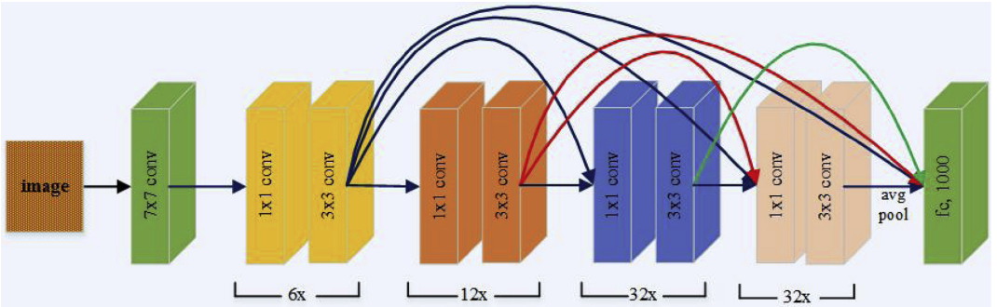
DenseNet Architecture
DenseNet: A Powerful CNN
DenseNet is a deep network known for its high performance in image classification tasks.
DenseNet connects each layer to every other layer, ensuring efficient feature reuse and improving accuracy.
DenseNet alleviates the vanishing gradient problem, which often plagues deep networks by allowing gradients to travel more directly between layers.
Why DenseNet for IPF Detection?
DenseNet is known for its high accuracy in medical image classification.
In our project, we aim to further improve DenseNet by building a system that not only achieves high accuracy but also detects IPF at earlier stages than current models.

Slide 8
Process: Hyperparameter Optimization
Hyperparameters in Our Network
To train our CNN, we need to optimize several hyperparameters:
Learning Rate: How quickly the model updates its weights.
Batch Size: The number of training examples in each batch.
Dropout Rate: The proportion of neurons ignored during training to prevent overfitting.
Epochs: The number of times the model sees the entire training set.
The importance of learning rate, batch size, dropout rate, and epochs depends on the specific model and dataset, but generally speaking, each one plays a distinct role in how well a model trains.
Using Transfer Learning
We also employ transfer learning by using a pre-trained model to leverage knowledge from previous tasks.
This allows us to start from a stronger baseline and improves our model’s ability to classify IPF accurately.
Finding the Optimal Combination
Learning rate is particularly influential in determining the model's convergence. A too-high learning rate may cause the model to miss optimal points, while a too-low rate may result in slow training.
The goal is to find an optimal combination of hyperparameters that results in minimal error.
We experiment with different combinations of:
Learning rates: 5e-4, 5e-5, 5e-6.
Batch sizes: 32, 64.
Dropout rates: 0.2 to 0.5.
Through experimentation, we aim to achieve a model with low error and high accuracy.

Slide 9
Measures of Model Performance
How We Measure Performance
Instead of relying on the outdated Confusion Matrix, we focus on more robust performance metrics:
Accuracy: The ratio of correct predictions (both positive and negative) to total predictions.
Precision: The percentage of positive identifications that were correct.
Recall (Sensitivity): The ability of the model to correctly identify positive cases.
F1 Score: The harmonic mean of precision and recall, providing a balance between the two, especially important for imbalanced datasets.
Why Not Use Confusion Matrix?
The Confusion Matrix is limited and does not provide a nuanced understanding of model performance, particularly for imbalanced datasets like IPF detection.
Instead, we rely on Precision, Recall, and F1 Score to give a clearer picture of how well the model performs in identifying true positives and minimizing false negatives.

Slide 10
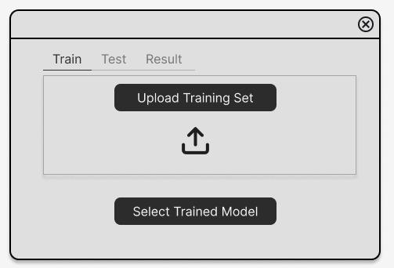
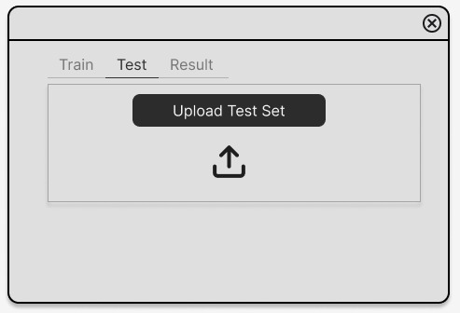
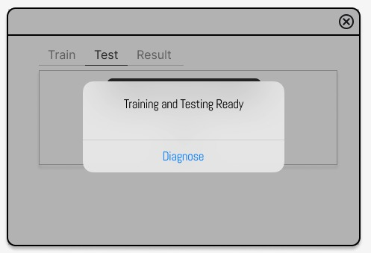
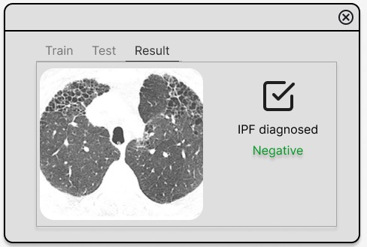
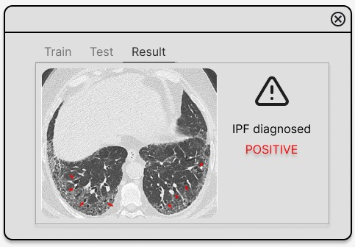
GUI

Slide 11
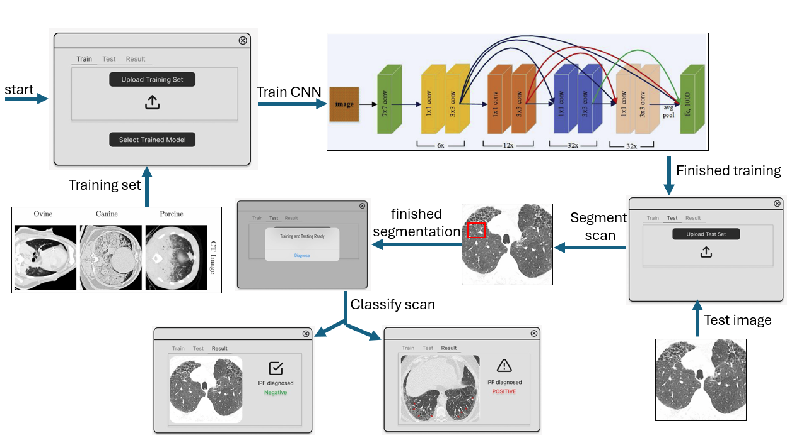
flow

Slide 12
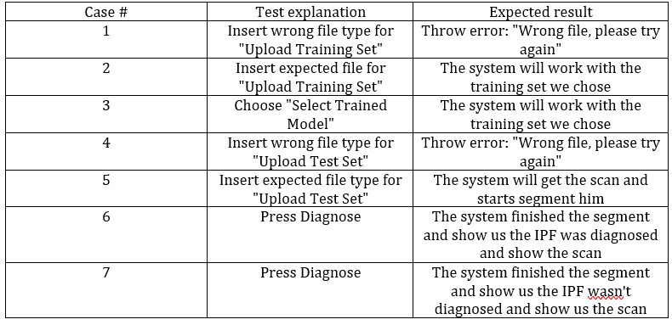
Evaluation / Verification plan

Slide 13
Conclusion
Key Takeaways
Idiopathic Pulmonary Fibrosis (IPF) is a serious, terminal disease that requires early detection for effective treatment.
Our system, based on deep neural networks, aims to detect IPF in its early stages, helping doctors diagnose more accurately and faster than traditional methods.
Advanced techniques like DenseNet and Transfer Learning provide a powerful framework for improving medical imaging diagnostics.
Looking Forward
Through hyperparameter optimization and continuous training, our model aims to achieve high accuracy with low error rates.
By leveraging AI-assisted diagnosis, we are taking a step towards improving patient outcomes and reducing suffering caused by IPF.

